Slide 1

VNS Health
Medicare Provider Orientation
Updated May 2024

Slide 2
Table of Contents
About VNS Health and The Benefits of Partnership
2024 VNS Health Health Plans
Provider Resources
Delegated Vendors
Provider Responsibilities
Billing and Claims Processing
Utilization Management
Grievances and Appeals
Compliance Program
Quality Improvement Program

Slide 3
About VNS Health and
The Benefits of Partnership

Slide 4



Just Some of the Reasons Why We Stand Out
Expertise
Excellence
Advocacy
Medicare and Medicaid
Helping your benefits work for you
Quality Care
Choice of outstanding doctors and hospitals
On Your Side
Champions for you and your loved ones

Slide 5

Core Values
Empathy
We seek to understand
others’ feelings and
experiences in order
to actively help.
Our Core Values are at the center of everything we do at VNS Health. They unify all team members around a set of shared principles and behaviors.
Integrity
We do the right
thing even when
no one is looking.
Agility
We use experience
and creativity to
move quickly.

Slide 6
2024 VNS Health
Health Plans

Slide 7

VNS Health EasyCare (HMO)
$0 Monthly plan premium (Part C), primary care copay, $35 specialist copay
Over-the-Counter (OTC) and GroceryCard ($225/monthly)
Prescription drug coverage (Part D) as low as $0
Dental: $2,000/year for comprehensive dental care
Vision: $0 copay exam, $200/year for eyewear
Hearing: $0 copay for exam, $1,000 every three years for hardware
Additional benefits
Acupuncture: 12 visits/year
Routine podiatry: six visits/year
Transportation to medical care: 11 round trips/year
Gym membership—SilverSneakers®
Telehealth
24/7 Nurse Hotline
Home delivered meals after a hospital stay

Slide 8

VNS Health EasyCare Plus (HMO D-SNP)
$0 Monthly plan premium (Part C), primary care copay, specialist copay
Over-the-Counter (OTC) Card ($225/monthly)
Prescription drug coverage (Part D) as low as $0
Flex Card ($350/year) to help pay for utilities, dental, hearings, and vision
Dental: $2,750/year for comprehensive dental care
Vision: $0 copay exam, $200/year for eyewear
Hearing: $0 copay for exam, $1,400 every three years for hardware
Additional benefits
Acupuncture: 30 visits/year
Routine podiatry: six visits/year
Transportation to medical care: seven round trips/year
Gym membership—SilverSneakers®
Telehealth
24/7 Nurse Hotline
Home delivered meals after a hospital stay

Slide 9

VNS Health Total (HMO D-SNP)
$0 Monthly plan premium (Part C), primary care copay, specialist copay
Over-the-Counter (OTC) and GroceryCard ($225/monthly)
Prescription drug coverage (Part D)
Flex Card ($760/year) to help pay for utilities, dental, hearings, and vision
Long-Term services and supports (including home health aide, nurse, and social worker)
Worldwide coverage—up to $50,000/year for emergency services and urgent care
Dental: $3,000/year for comprehensive dental care
Vision: $0 copay exam, $300/year for eyewear
Hearing: $0 copay for exam, $1,500 every three years for aids
Additional benefits
Acupuncture: 30 visits/year
Routine podiatry: six visits/year
Transportation to medical care: seven round trips/year
Gym membership—SilverSneakers®
Telehealth
24/7 Nurse Hotline
Home delivered meals after a hospital stay

Slide 10
VNS Health Medicare Service Area:
New York State
The following areas are serviced by VNS Health Medicare which includes EasyCare (HMO), EasyCare Plus (HMO D-SNP) and Total (HMO D-SNP). Albany The Bronx Kings (Brooklyn) Nassau County New York (Manhattan) Queens Rensselaer Richmond (Staten Island) Schenectady Suffolk County Westchester County
Counties covered
Visit our website for additional information: www.vnshealth.org/service-areas
Notes:
This slide is NOT pre-programmed into this PowerPoint file. Programmed slide special features do not apply.
Most elements on this slide are editable, moveable and can be deleted.
Please adhere to brand guidelines and instructions to ensure consistency.
To copy the NY map onto other slides: Click on the NY map section you require > ‘Copy’ and ‘Paste’ onto correct slide.
Can double click into grouping to select a specific region to recolor.
To add a footer: Click in the footer placeholder and start typing. Please make sure your footer text remains within this text box for consistency.
If deleted or missing: right click on thumbnail and ‘reset’ slide to bring text box back.
This slide CANNOT be reset to its original slide format after editing, as with programmed slides.
To return back to the original formatting: Select the original slide from the file download > ‘Copy’ the slide > ‘Paste’ > ‘Use destination theme’.

Slide 11

Medicaid Managed Long-Term Care (MLTC)
MLTC Benefits
VNS Health MLTC includes all the Medicaid long-term care and other health-related services members need to live well at home and in community, including:
$0 Monthly plan premium $0 Copays for covered services Care coordination from a dedicated care manager Medication management Home-delivered meals Home safety modifications/improvements Medical equipment and supplies Chore services and housekeeping Personal emergency response systems Adult day health care Social adult day care
Personal Care Home care 24/7 Nurse Support Line Nursing home care Respiratory therapy and oxygen Prosthetics and orthotics Dental, eye, foot, hearing care Medical equipment and supplies Nutritional counseling Telehealth

Slide 12
VNS Health Managed Long Term Care (MLTC) Service Area:
New York State
Our service areas: Albany The Bronx Columbia Delaware Dutchess Erie Fulton Genesee Greene Herkimer Kings (Brooklyn) Madison Monroe Montgomery Nassau New York (Manhattan) Niagara Oneida Onondaga | Orange Orleans Ostego Putman Queens Rensselaer Richmond (Staten Island) Rockland Saratoga Schenectady Schoharie Suffolk Sullivan Ulster Warren Washington Westchester Wyoming Wyoming
Counties covered
Visit our website for additional information: www.vnshealth.org/service-areas
Notes:
This slide is NOT pre-programmed into this PowerPoint file. Programmed slide special features do not apply.
Most elements on this slide are editable, moveable and can be deleted.
Please adhere to brand guidelines and instructions to ensure consistency.
To copy the NY map onto other slides: Click on the NY map section you require > ‘Copy’ and ‘Paste’ onto correct slide.
Can double click into grouping to select a specific region to recolor.
To add a footer: Click in the footer placeholder and start typing. Please make sure your footer text remains within this text box for consistency.
If deleted or missing: right click on thumbnail and ‘reset’ slide to bring text box back.
This slide CANNOT be reset to its original slide format after editing, as with programmed slides.
To return back to the original formatting: Select the original slide from the file download > ‘Copy’ the slide > ‘Paste’ > ‘Use destination theme’.

Slide 13

Ready to Refer to VNS Health MLTC?
It’s Easy!
To refer a patient to the VNS Health Medicaid Managed Long Term Care (MLTC) plan:
Discuss the plan with them
VNS Health MLTC Plan Brochure
Download PDF: English Spanish Chinese Russian Arabic
2. Get their permission for VNS Health to contact them
3. Complete and submit the referral form
4. If you have any questions, please call 1-855-282-4642.
You can also submit a referral via the Provider Portal: Log into your account Left side of screen, click on Patients, then click on Enrollment Referrals Click on Submit Referral, you will be directed to a form Complete and submit
Notes:
Portal Link:
www.vnsny.org/for-healthcare-professionals/physician-web-portal/hchb-provider-link/

Slide 14
SelectHealth
VNS Health
SelectHealth from VNS Health is a specialized Medicaid plan for people living with HIV, individuals of transgender experience, and gender non-conforming or people experiencing homelessness, regardless of HIV status.
SelectHealth covers a wide range of services: Medical and hospital services, dental, and vision care HIV and transgender healthcare specialists in hospitals, physician groups and private practices Medical specialists in other fields including cardiology, dermatology, pulmonary medicine and endocrinology Substance use treatment providers, behavioral health providers, and mental health specialists Culturally competent and gender-affirming services Care coordinators who tailor care and services to each individual member Coverage for dependent children
SelectHealth works with Carelon Behavioral Health (formerly Beacon Health Options) to provide these services.
More information on Home and Community Based Services can be found here.

Slide 15
SelectHealth
VNS Health
Service Area
The following areas are serviced by SelectHealth from VNS Health: The Bronx Kings (Brooklyn) Nassau New York (Manhattan) Queens Westchester
Counties covered
Notes:
This slide is NOT pre-programmed into this PowerPoint file. Programmed slide special features do not apply.
Most elements on this slide are editable, moveable and can be deleted.
Please adhere to brand guidelines and instructions to ensure consistency.
To copy the NY map onto other slides: Click on the NY map section you require > ‘Copy’ and ‘Paste’ onto correct slide.
Can double click into grouping to select a specific region to recolor.
To add a footer: Click in the footer placeholder and start typing. Please make sure your footer text remains within this text box for consistency.
If deleted or missing: right click on thumbnail and ‘reset’ slide to bring text box back.
This slide CANNOT be reset to its original slide format after editing, as with programmed slides.
To return back to the original formatting: Select the original slide from the file download > ‘Copy’ the slide > ‘Paste’ > ‘Use destination theme’.

Slide 16
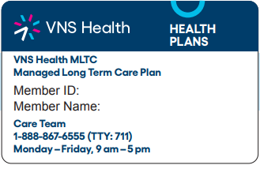
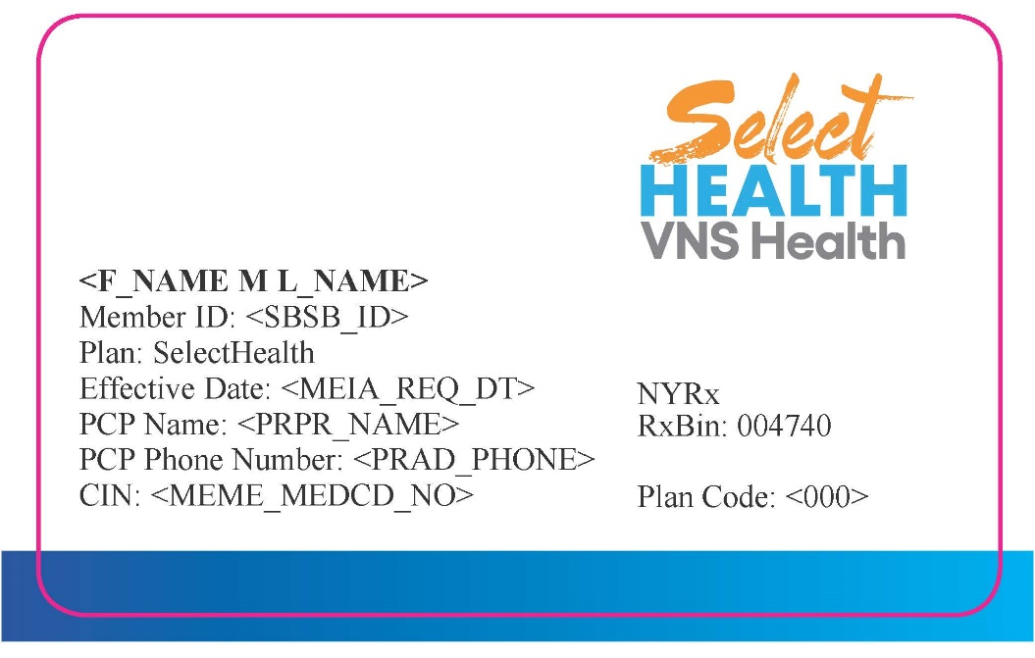
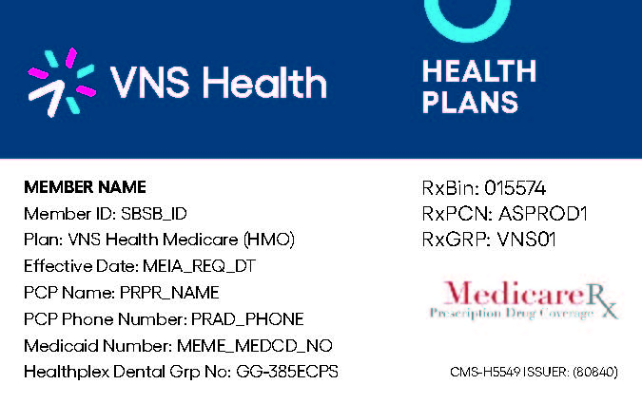
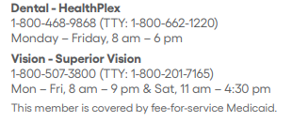
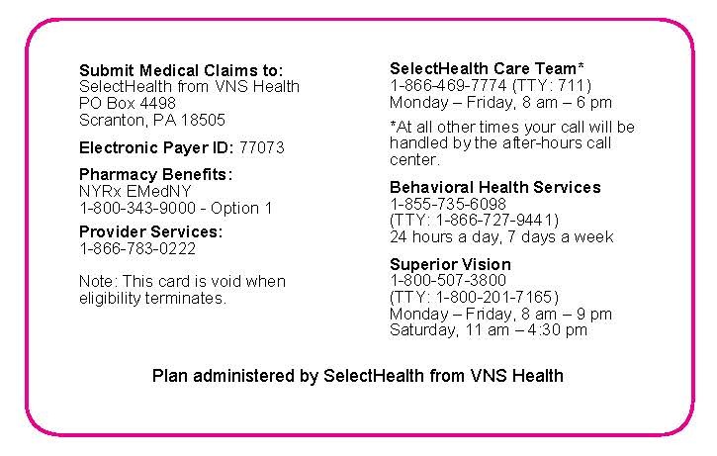
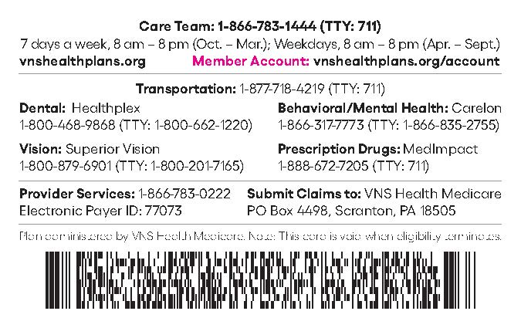
VNS Health Member Sample ID Cards
MLTC Sample ID Card:
SelectHealth from VNS Health Sample ID Card:
EasyCare, EasyCare Plus and Total (MAP) Sample ID Card:

Slide 17

Provider Resources
This Photo by Unknown Author is licensed under CC BY-NC-ND
Notes:
Next, we will review the contracted supplemental benefits vendors.

Slide 18

Provider Reference Guide
Quick Reference Guide Content: Member and provider contact centers claims process Online resources Electronic Funds Transfer (EFT) Reinstatement of services Service authorization requests and changes Member referrals and inquiries Ancillary vendors

Slide 19

Website: vnshealthplans.org
Providers have access to a variety of easy-to-use reference materials Provider portal Provider toolkit Claims, billing, and payments Credentialing Notices, news, and updates Formulary search All provider forms Provider manual Quick reference guide Helpful links

Slide 20

Provider Portal
Your one-stop shop for: Patient Membership roster and PCP panel Eligibility search Enrollment referrals Admission, discharge, and transfer (ADT) alerts Claims Authorizations Provider Directory Formulary Search Provider Toolkit Appeals and Disputes Communications Center Resources My Account

Slide 21
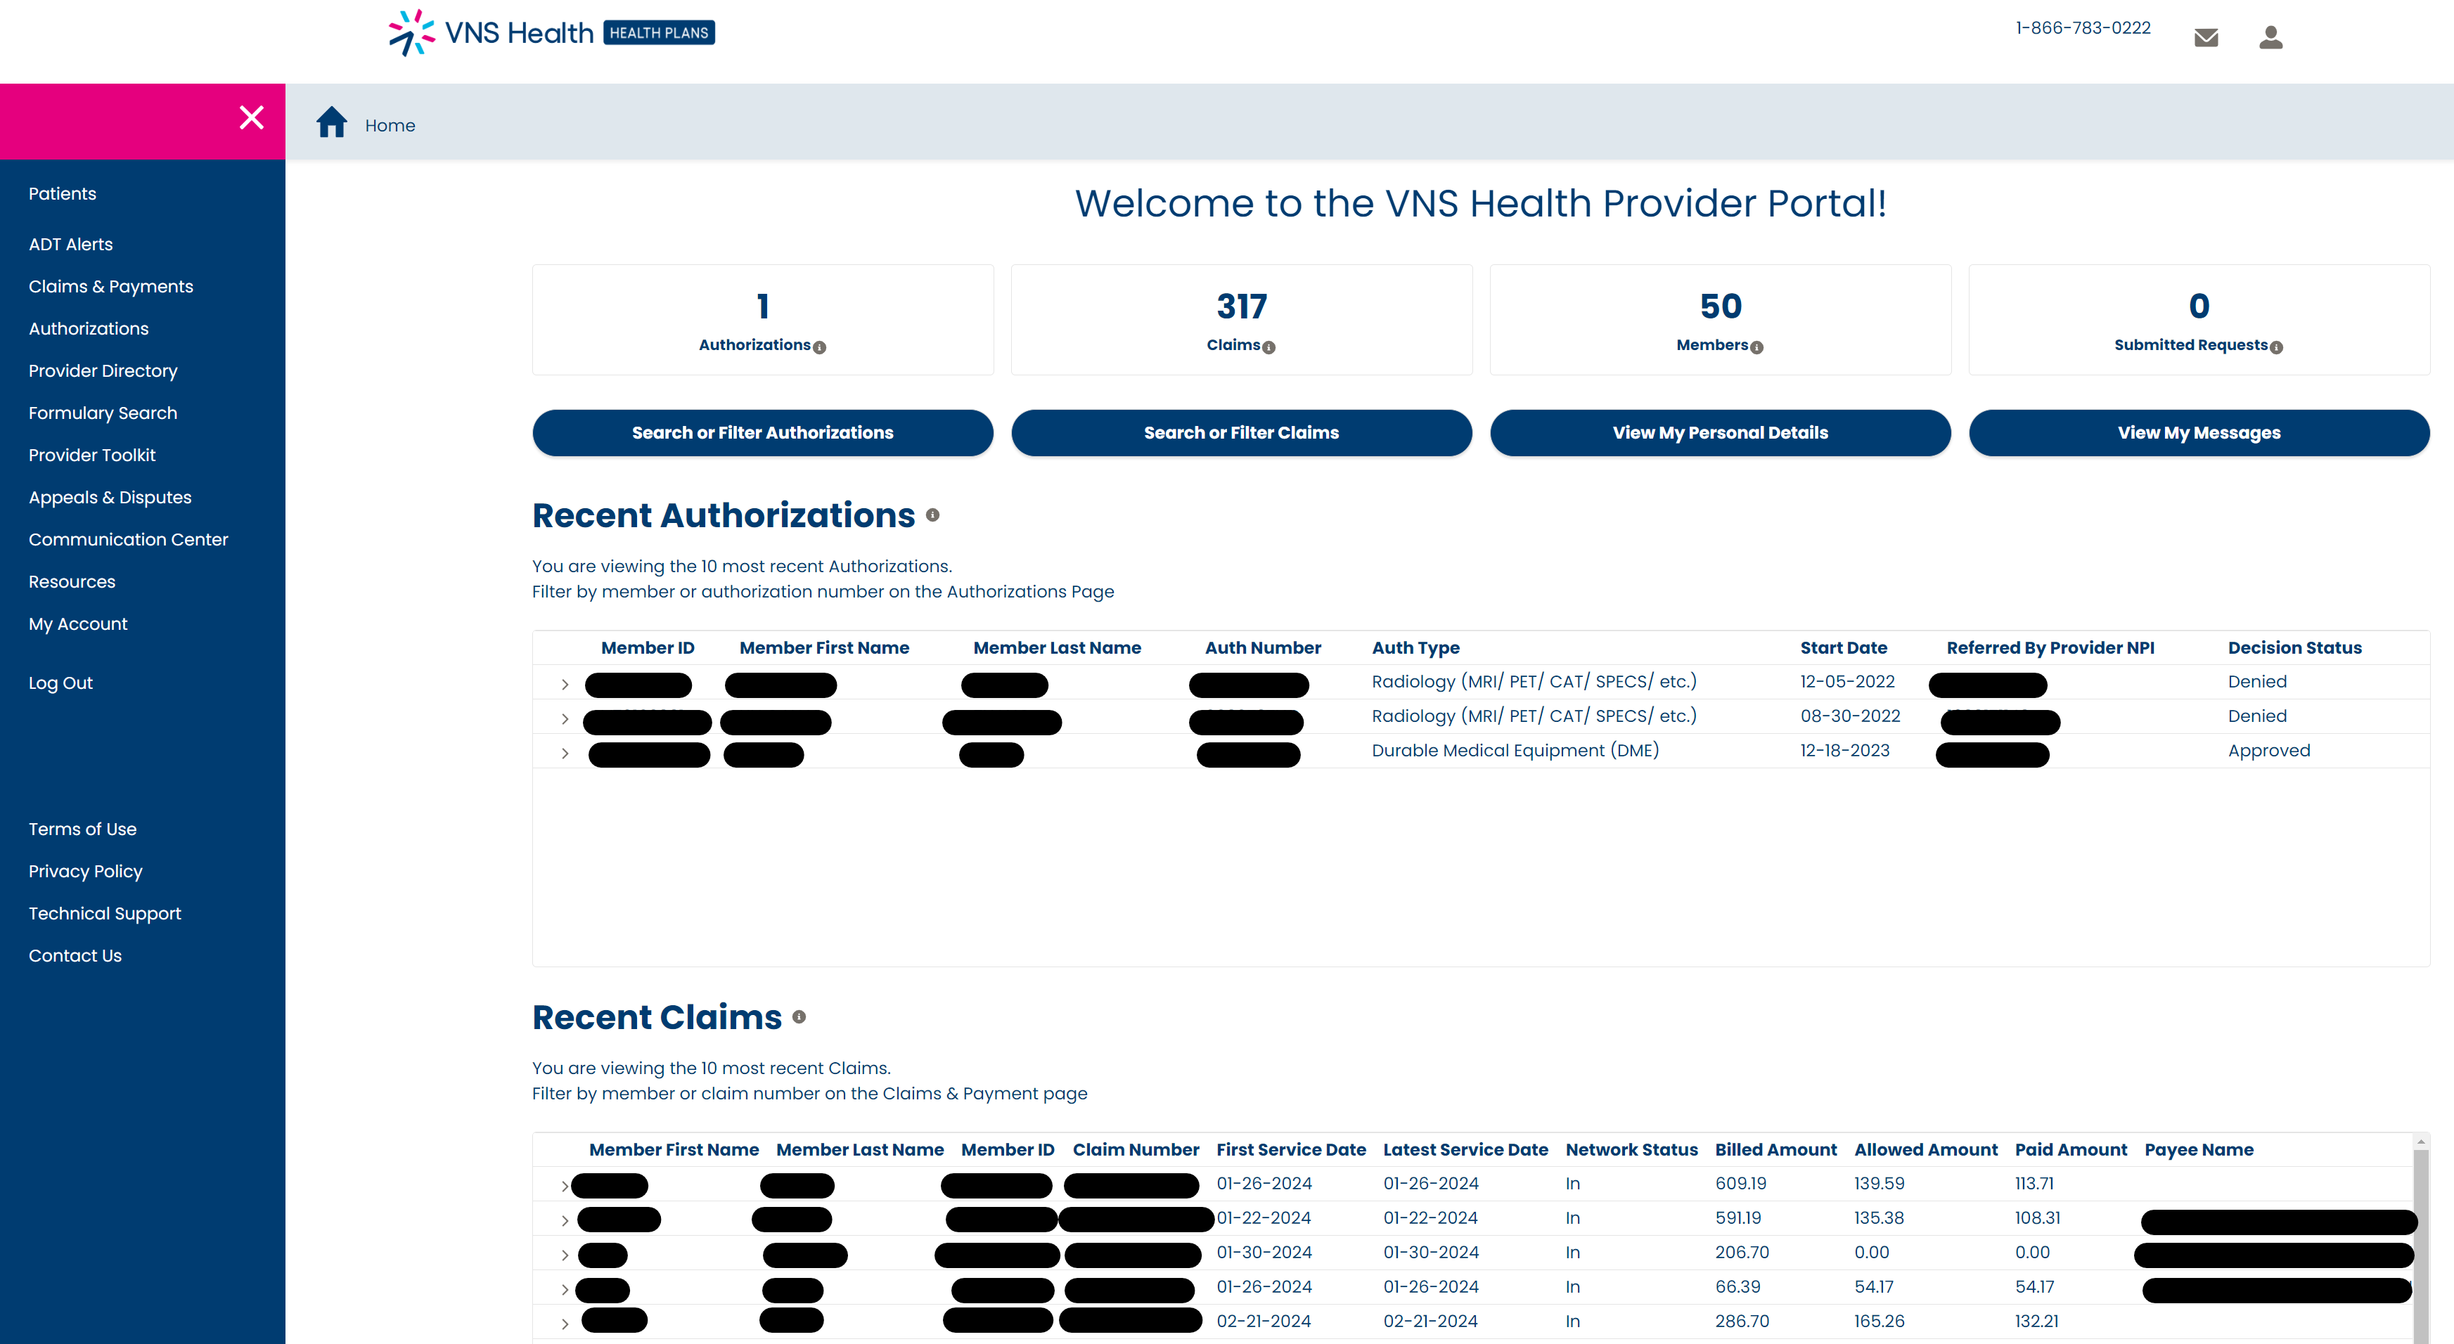
Provider Portal View - Dashboard

Slide 22

Helpful Links and Contacts
Join Our Provider Network Provider Demographic Update Form Provider Credentialing Request Form EFT Request Form Availity Provider Claims Dispute Form Filing an Appeal Phone: 1-866-867-6555 Fax: 1-866-791-2213 Mail: P.O. Box 445 Elmsford, NY 10523 Attn: VNS Health Grievance & Appeals

Slide 23
Delegated Vendors
© Copyright 2024 VNS Health. All rights reserved.

Slide 24

Pharmacy - MedImpact
The MedImpact physician support center features pharmacy benefit-related information as well as self-service tools to help physician providers provide quality, cost-effective pharmacy services. Provider Portal Formulary List 2024 Prior Authorization Requirements EasyCare EasyCare Plus and Total Online form Request for Medicare Prescription Coverage Determination Form Request for Medicare Prescription Coverage Redetermination Form
MedImpact Customer Service: 1-800-788-2949 Expedited Appeal Request: 1-866-783-1444 | Address: MedImpact Healthcare Systems 10181 Scripps Gateway Court San Diego, CA 92131 | Fax Number: 1-858-790-7100 Expedited Appeal Fax: 1-858-790-6060

Slide 25
Medication Request Form
NYRx, the Medicaid Pharmacy Program: all Medicaid members enrolled in Mainstream Managed Care receive their prescription drugs through NYRx, which allows New York State to pay pharmacies directly for the drugs and supplies of Medicaid members.
NYS Medicaid Prior Authorization Request Forms For Prescriptions
Standard PA form
To request a PA:
Call NYS Medicaid PA call center at (877) 309-9493 and select option “1” for the prescriber.
The call center is operational 24 hours a day, seven days per week.
Completed PA forms can be faxed to NYS Medicaid at (800) 268-2990.
Fax requests may take up to 24 hours to process.
© Copyright 2024 VNS Health. All rights reserved.

Slide 26

Transportation
VNS Health EasyCare (HMO) and EasyCare Plus (HMO D-SNP) ModivCare Tel: 1-866-428-2351 If possible, please have the following information ready: Date of the trip, pick-up time, medical office full street address, telephone number, and any special needs (ex., wheelchair). Member must arrange trip at least two days before appointment. Can book 30 days ahead of appointment. VNS Health Total (HMO D-SNP) For non-emergency transportation by ambulance because of a medical condition, please call ModivCare Tel: 1-877-718-4220 (TTY: 711), 7 days a week, 8 am–8 pm. For non-emergency medical transportation, member or provider must contact the Statewide Transportation Broker, Medical Answering Services (MAS): Online Call Monday–Friday 7am to 6pm (New York City, Long Island, Westchester, and Putnam counties) – 1-844-666-6270 (Upstate) – 1-866-932-7740 Transportation requirements: Scheduled three days prior Provide appointment date, time, address, provider’s name, Medicaid ID number, any special needs For more information, visit the New York State Department of Health Transportation page
© Copyright 2024 VNS Health. All rights reserved.

Slide 27

Dental - HealthPlex
Healthplex is delegated to manage appeals, claims processing and payment, credentialing and recredentialing, network development and management, and utilization management. All dentists will receive a Healthplex provider manual and the appropriate forms when they contract with Healthplex. HealthPlex provider line: 1-888-468-2183 Email: info@Healthplex.com HealthPlex Portal Members must identify themselves as VNS Health members and bring their Healthplex card. If asked for ID number, please use this list to select associated number: EasyCare: ID D0032069 EasyCare Plus: ID D0032068 MLTC downstate: ID D0032066 MLTC upstate: ID D0032066 TOTAL: ID D0032067 SH-HARP adult: ID D0037618 SH-HARP children: ID D0037618 LTSS adult: ID D0032065 LTSS children: ID D0032065 Medicaid adult SNP: ID D0032065 Medicaid children SNP: ID D0032065

Slide 28
Carelon Behavioral Health
Carelon Behavioral Health has been delegated to manage the following services: appeals, claims processing and payment, credentialing and recredentialing, customer service, network development and management, and utilization management. Products: VNS Health EasyCare (HMO), EasyCare Plus (HMO D-SNP), Total (HMO D-SNP), and SelectHealth from VNS Health Carelon Behavioral Health: 1-800-397-1630 Carelon portal Outpatient review form—adult day treatment Completed form fax: 1-800-441-2281 or 1-781-994-7634

Slide 29

Superior Vision by VersantHealth
Superior Vision is a specialty health benefits company that manages routine (wellness) exams and eyewear and is delegated to complete claims processing and payments and credentialing and re-credentialing. Products: VNS Health EasyCare (HMO), EasyCare Plus (HMO D-SNP) and Total (HMO D-SNP) Superior Vision by VersantHealth: 866-819-4298 Superior Vision Portal Quick Reference Guide

Slide 30
Provider Responsibilities

Slide 31

Provider Responsibilities
VNS Health maintains provider agreements that incorporate provider and health plan responsibilities consistent with industry standards in compliance with New York State Managed Care Legislation and requirements for individuals and organizations receiving federal funds. The following requirements are applicable to VNS Health participating providers. Nondiscrimination Cultural competence Program participation and compliance Release of member information Billing Provider information Access and availability standards Credentialing Recredentialing Provider terminations and continuity of care

Slide 32

Billing and Claims Processing
Notes:
Next, we will review the contracted supplemental benefits vendors.

Slide 33
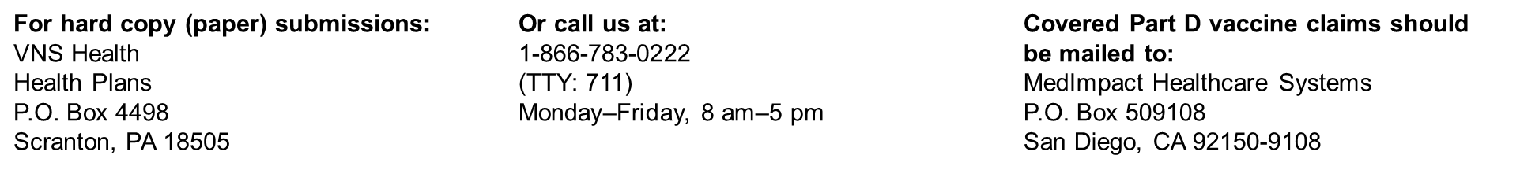
Availity
The preferred Electronic Data Interchange (EDI) and vendor for all health plan transactions. Availity works with providers and their vendors to avoid disruption in transaction transmissions. The existing Payer IDs — 77073 and VNS Health — are not changing and will be used moving forward. If you wish to submit directly, you can connect directly to the Availity Gateway at no cost for all VNS Health Plans 837, 835, and 27X transactions. Go to https://apps.availity.com/web/welcome/#/edi and availity.com/vns to set up your business or vendor for submitting EDI transactions through Availity. Availity’s Provider Engagement Portal is accessible for eligibility and benefits inquiry, claim submission, claim status inquiry, and electronic remittance advice. Please ensure you are registered with Availity for this access. For questions or assistance, contact Availity Client Services 1-800-Availity (1-800-282-4548), Monday–Friday, 8 am–8 pm (ET)
Notes:
For this reason, we’d like to share important information regarding your electronic claim submission, eligibility status verification, electronic remittance advice, and claim status verification

Slide 34
Billing and Claims Processing
Adhere to timely filing requirements: Submit claims within the specified timeframe to avoid denials based on lateness. Below are general claims dispute timelines for reference. However, providers must abide by the time frame stipulated in their contract for claims to be processed and disputes to be considered. Claims: 90 days to submit clean claims from the date of service (or the time frame stipulated in your contract) and 60 days to dispute a claim from VNS Health issued Remittance. Please be sure your claim has these required data elements before submitting your form. This information is needed for claims to be processed correctly: The CMS-1500 claim form (sample) and UB-04 claim form (sample) can be used to bill fee-for-service encounters. The UB-04 claim form should be used by facilities and by facilities billing on behalf of employed providers. You can find instructions for submitting your claim by clicking on “How to submit claims” above. Provider claims dispute form: This form is for the sole purpose of submitting a Claim Payment Inquiry related to the adjustment of a claim. This is not to replace the Appeal process. https://www.vnshealthplans.org/provider-claims-dispute-form/ Filing an appeal: All claim appeals must be filed in writing and must be filed within 60 calendar days of our initial decision about the request or as otherwise specified in the provider contract. Phone: 1-866-867-6555 Fax: 1-866-791-2213 Mail: P.O. Box 445 Elmsford, NY 10523 Attn: VNS Health Grievance & Appeals

Slide 35
Utilization Management
© Copyright 2024 VNS Health. All rights reserved.

Slide 36
Process and Timeline
Reviews member records and utilizes clinical criteria, guidelines, and regulations to determine the medical necessity of a service. Process: Service request (SR) by phone, fax, or mail is taken by Authorization Team. Authorization Team determines if SR can be processed or requires clinical Utilization Management (UM) review If UM review is required, the authorization is assigned for clinical and medical director review Timeline: Expedited requests - regulatory timeframe provides up to 72 hours to decide (approval or denial) Reserved for requests that the member faces life-threatening risk Also applicable for requests that are made in conjunction with a facility discharge or within seven days of discharge Standard requests - regulatory timeframe provides up to 14 days Extensions allowed for both expedited and standard requests when it is in the best interest of the member
Fax number: Medicare/Total: 866-791-2214 MLTC: 212-897-9448 SelectHealth: 646-459-7731 Escalation only: Provider.Inquiries@vnshealth.org

Slide 37
Grievances and Appeals

Slide 38

Grievances and Appeals Decisions
When a VNS Health Medicare plan makes a decision related to payment coverage requests or an item provision, service, or drug, the terminology may differ depending on what is being requested, but they all mean an initial request:
Organization determination – Part C benefits
Coverage determination – Part D benefits
Initial determination – can be used for both Part C and D benefits
These decisions, when not fully favorable, are subject to appeal, and our initial decision notices will provide you with your appeal rights. For our Medicare plans, Part C service appeals are broken down further for Part B drugs which are typically those drugs that are administered in the office by a physician.

Slide 39
Appeal Types, Timeframes, and Rules
Appeal type | Decision timeframe | Rules/requirements
Expedited Part B drug appeal | 72 hours | May be submitted verbally or in writing. The appeal will be expedited when: A physician indicates or VNS Health determines that waiting for the appeal decision within the standard timeframe may risk or jeopardize the member’s health. A member may also request to expedite an appeal; however, the plan may deny and process it within the standard track is the plan determines that the member’s health will not be at risk.
Expedited Part C service/benefit appeal | 72 hours, with a possible 14-day extension
Standard Part B drug | Seven days | May be submitted verbally or in writing.
Standard Part C service/benefit appeal | 30 calendar days, with a possible 14-day extension
Claim appeal | 60 calendar days | Must be submitted in writing Cannot be expedited Cannot be extended

Slide 40
Request Requirements
The What and Where’s:
When submitting an appeal, at minimum, the following should be included in the request:
Your name/who is filing the appeal, preferably on your office’s letterhead which includes treating/requesting physician’s
  Name
  Address
  Phone Number
Member’s name and other type of member identifier such as
  VNS Health member ID number
  Date of birth
Service or claim that is being appealed, and the reason why
Supporting documentation such as clinical documentation/medical records, proof of timely filing (for claim appeals), or any other documents you feel may help support the appeal
Phone: 1-866-867-6555
Fax: 1-866-791-2213
Mail: P.O. Box 445
Elmsford, NY 10523
Attn: VNS Health Grievance & Appeals

Slide 41
Compliance Program

Slide 42
Fraud, Waste and Abuse (All Plans)
VNS Health policy: comply with all federal and state laws regarding fraud, waste, and abuse. We will implement and enforce procedures to detect and prevent fraud, waste, and abuse regarding claims submitted to federal and state healthcare programs, and to provide protection for those who report in good faith actual or suspected wrongdoing. The compliance policy: we maintain a strict policy of zero tolerance toward fraud and abuse and other inappropriate activities. Individuals who engage in any inappropriate activity alone or in collaboration with another employee, member, or provider are subject to immediate disciplinary action, up to and including termination. Definitions: Fraud—An intentional deception or misrepresentation made by a person with the knowledge that could result in some unauthorized benefit to themselves or other person(s). Includes any act that constitutes fraud under applicable federal or state law. Waste—The extravagant, careless, or needless expenditure of funds resulting from deficient practices, systems, controls, or decisions. Abuse—Provider practices that are inconsistent with sound fiscal, business, or medical practices and result in an unnecessary cost or reimbursement for services that are not medically necessary or fail to meet professionally recognized standards of care. Also includes enrollee practices that result in unnecessary cost.

Slide 43
Fraud, Waste and Abuse (All Plans)
Relevant Statutes and Regulations Stark Law: with several separate provisions, governs physician self-referral for Medicare and Medicaid patients. Physician self-referral is the practice of a physician referring a patient to a medical facility in which he has a financial interest, be it ownership, investment, or a structured compensation agreement. False Claims Act (FCA): Using the FCA, private citizens (i.e., whistleblowers) can help reduce fraud against the government. Reporting of fraudulent, wasteful, and abusive activities We expect members, vendors, providers, interns, volunteers, consultants, board members, and First Tier, Downstream and Related Entities (FDRs) as well as others associated with our business to bring any alleged inappropriate activity which involves VNS Health to our attention. Providers may confidentially report a potential violation of our compliance policies or any applicable regulation by contacting: VNS Health Compliance Officer 220 East 42nd Street 6th Floor New York, NY 10017 Email – SIUmailbox@vnshealth.org
Report fraud, waste, and abuse anonymously to Ethics Point, Inc., a contracted vendor, by using the
VNS Health Hotline at 1-888-634-1558 or online. This service is available 24/7.

Slide 44
Quality Improvement Program

Slide 45
Quality Improvement Program
Mission: serve as a best-in-class health plan and continually improve the quality of healthcare for our members. How: providing access to affordable, appropriate, and timely healthcare and services, which are routinely assessed for compliance with established standards. Participating providers must comply with all VNS Health Quality Management policies, procedures, and programs. Goal: develop an integrated and comprehensive approach to continuously improving care and service to meet or exceed our members’ expectations. Program framework: based upon the philosophy of continuous quality improvement and includes: • Development of quality improvement initiatives • Quality measurement and evaluation • Corrective action implementation and evaluation • Communication with and education of our members and providers • Annual evaluation of the program’s effectiveness

Slide 46
Improving Health Outcomes and Quality Performance
VNS Health collaborates with providers to share data bi-directionally to address care gaps.
Request: to make the provider experience as efficient and rewarding as possible, we invite providers to participate in our automated data collection program supporting Healthcare Effectiveness Data and Information Set (HEDIS®) and Quality Assurance Reporting Requirements (QARR) supplemental data. Reduce your office staff’s administrative burden of collecting medical records if you use a secure Electronic Medical Record (EMR).
Process: we ask for an IT contact to assist in setting up a Secure File Transfer Protocol (SFTP). This standard network protocol is used for the secure file access, transfer, and management of any data stream. We will also request assistance on your end to establish and send a quarterly report. For the first initial files submitted, and subsequently once per annum, we will request a medical chart sample to conduct primary source verification. The data through this program include:
Gaps in Care reports: Shared monthly via the VNS Health provider portal, displaying member level adherence across each quality measure (Total, EasyCare Plus, EasyCare, and SelectHealth)
Supplemental data files: Providers leverage the standardize format to submit clinical supplemental data to close gaps in care to the plan reducing medical record requests
1. Gaps in Care report
is shared by VNS Health*
2. Gaps are reconciled
by partnering provider
4. VNS Health feedback is
provided, including gaps
closed and technical
issues encountered
3. Provider EMR data is
shared with VNS Health
quarterly to indicated
gap closure and measure
adherence
*Generally monthly, the frequency of the Gaps in Care report will differ by provider.

Slide 47
Quality Chart Collection Project Timelines
Medical record data may be requested to support several quality initiatives at different times during the year.
Project | Timeframe | Description
Supplemental data collection | Year-round | Clinical data requests to close gaps in care
HEDIS medical record review project | February—May 5th | Medical records requested by hybrid measures
IPRO chart review | Ad hoc | Medical records requested to support DOH char reviews and case studies
Clinical practice guidelines audit | Annual | Medical records requested to assess adherence with VNS Health guidelines

Slide 48
Questions?

Slide 49
Appendix

Slide 50
2024 VNS Medicare Advantage Plans
VNS Health EasyCare (HMO)
VNS Health EasyCare Plus (HMO D-SNP)
VNS Health Total (HMO D-SNP)
$0 Monthly plan premium (Part C), Primary care copay $35 Specialist copay Prescription drug coverage (Part D) as low as $0 Over-the-Counter (OTC) Card ($87/quarter) Dental $2,000/year Vision $0 copay exam, $200/year for eyewear Hearing $0 copay for exam, $1,000 every 3 years for aids Acupuncture 12 visits/year Routine podiatry 6 visits/year Transportation to medical care 11 round trips/year Gym membership—SilverSneakers® Telehealth 24/7 Nurse Hotline Home delivered meals after a hospital stay – 28 meals over a 2-week period. Up to 3 inpatient hospital visits/year
$0 Monthly plan premium (Part C), Primary care copay, Specialist copay Prescription drug coverage (Part D) as low as $0 Over-the-Counter (OTC) Card ($225/monthly) Flex Card $350/year to help pay for certain utilities and dental, hearing, and vision expenses. Dental $2,750/year for comprehensive dental care Vision $0 copay exam, $200/year for eyewear Hearing $0 copay for exam, $1,400 every 3 years for hardware Acupuncture 30 visits/year Routine podiatry 6 visits/year Transportation to medical care 7 round trips/year Gym membership—SilverSneakers® Telehealth 24/7 Nurse Hotline Home delivered meals after a hospital stay—28 meals over a 2-week period Up to 3 inpatient hospital visits/year
$0 Monthly plan premium (Part C), Primary care copay, Specialist copay and Prescription drug coverage (Part D) Over-the-Counter (OTC) Card ($266/monthly) Flex Card $760/year to help pay for certain utilities and dental, hearing, and vision expenses. Dental $3,000/year for comprehensive dental care Vision $0 copay exam, $300/year for eyewear Hearing $0 copay for exam, $1,500 every 3 years for aids Acupuncture 30 visits/year Gym membership—SilverSneakers® Telehealth 24/7 Nurse Hotline Long-Term services and supports (including home health aide, nurse, and social worker) Worldwide coverage—Up to $50,000/year for emergency services and urgent care Home delivered meals after a hospital stay—28 meals over a 2-week period Up to 3 inpatient hospital visits/year

Slide 51
Helpful Links and Contacts
Join Our Provider Network: If you are interested in joining the VNS Health Plans Provider network, please fill out the following form https://www.vnshealthplans.org/join-our-network-form/ as accurately as possible. Once your request has been reviewed for network need, you will be notified by mail. Submission of this form does not guarantee participation with our Health Plans. Provider Demographic Update Form: https://www.vnshealthplans.org/provider-demographic-update-form/ Provider Credentialing Request Form: https://www.vnshealthplans.org/health-professionals/credentialing/ EFT Request Form: If you are interested in enrolling in EFT (Electronic Funds Transfer) for VNS Health Plans please fill out the required form. https://www.vnshealthplans.org/provider-eft-request-form/ Please allow VNS Health Plans 10 business days to have your EFT approved and set up. Any inquiries regarding EFT set up and status can be directed to VNS Health Plans Provider Services at 866-783-0222. Availity: Please note that to begin receiving EFT payments and remittances, you will also need to enroll with Availity to receive electronic remittance advice files. Registration link: https://www.availity.com/Essentials-Portal-Registration Provider Claims Dispute Form: This form is for the sole purpose of submitting a Claim Payment Inquiry related to the adjustment of a claim. This is not to replace the appeal process. https://www.vnshealthplans.org/provider-claims-dispute-form/ Filing an Appeal: All claim appeals must be filed in writing and must be filed within 60 calendar days of our initial decision about the request or as otherwise specified in the provider contract. Phone: 1-866-867-6555 Fax: 1-866-791-2213 Mail: P.O. Box 445 Elmsford, NY 10523 Attn: VNS Health Grievance & Appeals

